Slide 1



Slide 2



Problem
Trust organizations manage all aspects of finances for clients
and locating that information in a timely manner across multiple systems
is inefficient and time consuming.
“
Not happy with limited functionality of current solution, looking for integrated product. Our biggest pain point is workflow.
What would make us a 10 on the happiness scale is an integrated software that gave us a dashboard to view multiple pieces of information regarding an account in one place.
We need a software that integrates with our other systems to consolidate information, facilitate on-boarding new clients, and it must have a very nice user interface.

Slide 3






Solution
Information consolidation
  Informative dashboard
  Information in one system
Workflow management – client on-boarding
Integration with other operational systems
Efficiency
No 3rd-Party Product Dependency, i.e. Salesforce, MS Dynamics CRM
Compliance reporting

Slide 4







Current State
Cloud-Based SaaS Solution
Marketing
Relationship Management
Exception & Compliance Reporting
Notes
Document Management
Investment Management

Slide 5








Future State
Workflow Management
Flexible Relationship Management
Enhanced dynamic reporting
Improved,
more focused, dashboard widgets
Updated to current technology
Investment Management
Document Management
Notes

Slide 6
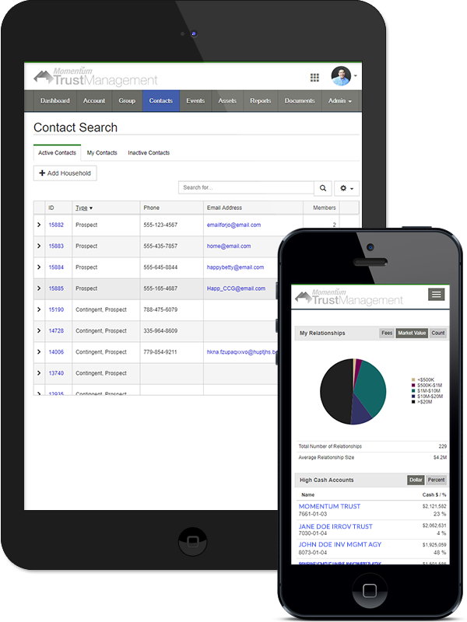
Partnering with Momenum3 allows us to provide integration services and customization that other software vendors simply can’t offer.
This product will allow customers to achieve a level of efficiency thru integration and consolidation that is lacking in the in the space.
This one product is the core operational system for a large Trust Management company today. It is used by Trust professionals to manage and organize their day, view and report asset performance, and to manage all communication with customers
Developed by a team that has been building software for over 25 years in cooperation with one of the largest privately held Trust companies in the United States.

Slide 7







Our product will:
Bring multiple required functions under a single, integrated platform
Support client on-boarding workflow
Not require any other 3rd party software products
Be capable of integrating with any existing operational products/systems
Have a flexible pricing model
Be a SaaS solution offering low startup costs and TCO

Slide 8

Value Proposition
Save time by aggregating relevant client information into a single location to improve efficiency
Save money by reducing the number of applications necessary to perform daily core operational tasks
Attract new business by providing leading edge technology and mobile access to information

Slide 9




Business Model
Tiered monthly license fees
Allows smaller shops to afford the software
Capitalize on volume for large shops
1-Time license fees
80% margin – cover new customer setup
Integration services
Make margin on integration services charged on T&M basis. Outsourced

Slide 10
Business Model
Numbers based on research of 156 potential discovery calls.
The published revenue numbers of those organizations and deriving from that their number of asset accounts under management.
*Received in initial contract month only (1-Time Fee)
$$ Data conversion/integration/customization revenue will be in addition to the revenue shown above.
$$ 40 Customers, on average = $3M annual revenue. That is a target for an event. $30M value.

Slide 11


Market
COMPANY PROFILE
Trust companies nation-wide with AUM between $1B and $20B
Bank and Trust companies
Law firms that manage trusts
INITIAL TARGET MARKET
SEI customers: 8900 clients, $576B AUM
  Already have integration with their software
  Increased margins
Warm leads from contacts in HubSpot and Discovery calls
  Several of these folks have asked us to call them back once we have the product
Getting leads now from our web site without any marketing

Slide 12





Warm Leads
These companies have asked us to call them when we have the system we are proposing…

Slide 13
Go-to-Market Strategy
01
02
03
04
Launch digital marketing campaign.
We are getting leads now, with no marketing efforts, via our web site
Call on shops that we spoke with during discovery calls that asked us to call them back
Call on SEI clients (8,900)
Given a sales cycle of up to 12 months, begin sales process while software is being enhanced. Possible to implement as-is and add functionality as it becomes available
** The reason for the long sales cycle, customers begin searching about 12 months prior to current contract ending with current provider

Slide 14
The Team
WES BUXTON
Technical Founder
Technology leader for over 24 years
CIO – Seminole Energy Services, 6+ years
Part-Owner/CIO/COO – THG Energy, 4+ years
Founder/Owner – Momentum3
Business Development/Product Functional Oversight
Profile created with help of business expert that helped us build the software. Will also help us with the search.
Outsourced
Momentum3
Deeply experienced software development company
Digital marketing

Slide 15

WE ARE ASKING FOR $650,000
Installments made over
an 18-month period
as milestones are met

Slide 16

Use of Funds
 | 3 Months | 6 Months | 12 Months | 18 Months
Product Development | Requirements defined | New functionality Complete | Minor product improvements
Custom Acquisition | Define/Refine sales strategy/Begin Sales | Focused/Aggressive sales efforts | 6+ Customers | 12+Customers
Expected Revenue | - | - | $25,000/mo | $35,000/mo
Investment Amount | Seed $180,000 | Seed $180,000 | Seed $80,000 | Seed $50,000
Investment Use of Funds | Product Dev/SME Position/Marketing |  | SME Position/Marketing/Sales Support Position/Minor product improvements
Hiring Plan | Hire SME/Sales position Contract everything else |  | Hire sales support, outsource product support, acctg, legal, etc.

